Slide 1
Chapter 29 The Electrical Properties of Materials

Slide 2
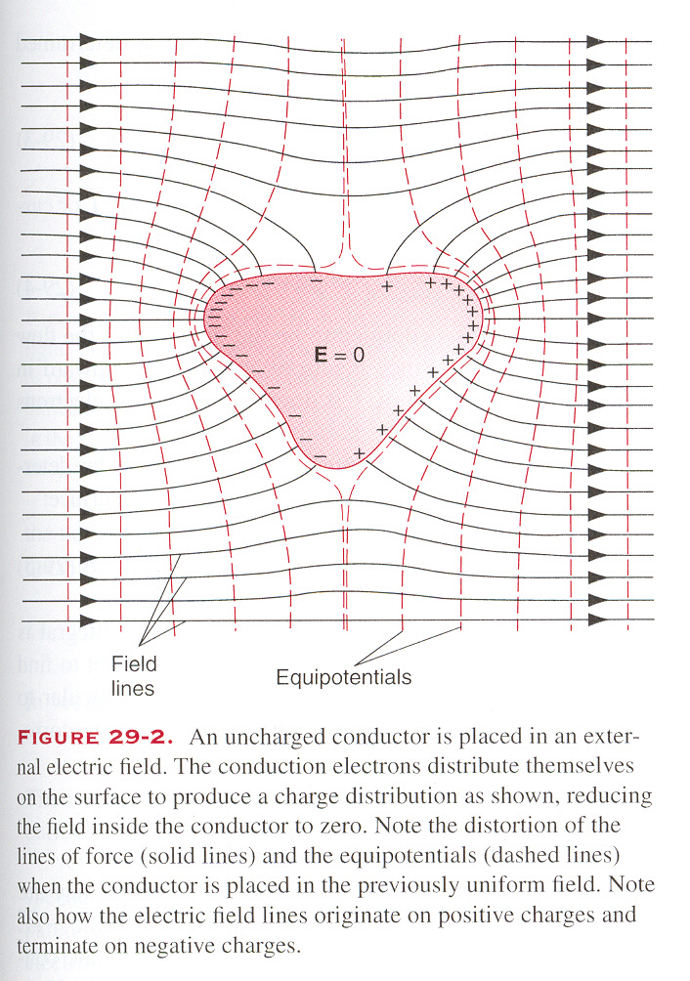
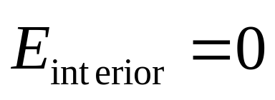
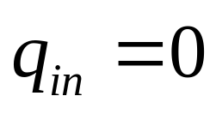
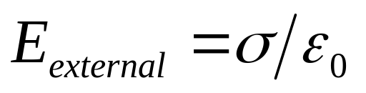
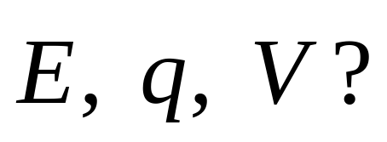
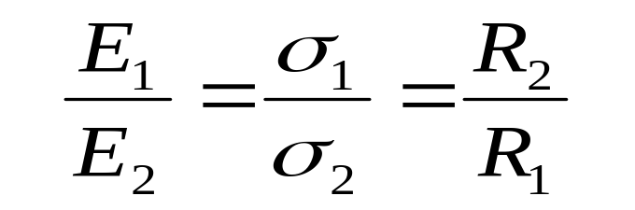
The electrostatic equilibrium will be achieved
conductor
The conductor becomes an equipotential, and its surfaces become equipotential surfaces.
In the external space, the electric lines are perpendicular to these surfaces.

Slide 3
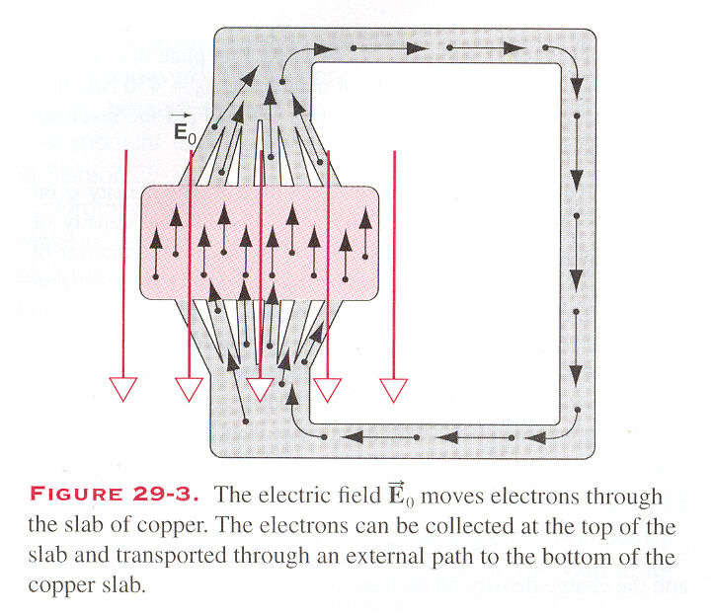
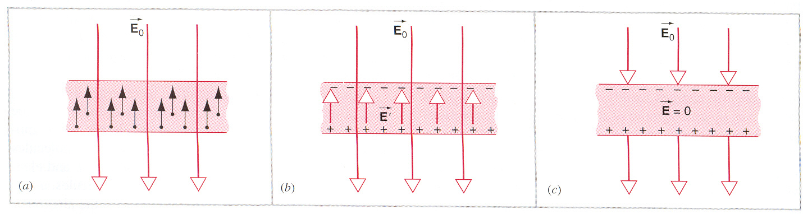
A Conductor in an Electric Field:
As a result, it prevents the flow of additional electrons.
Electric Current
By some mechanisms, the induced electrons are removed from one boundary of the conductor, through an external path, to another boundary:
There is no electric current

Slide 4
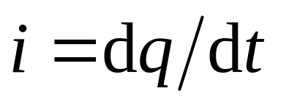
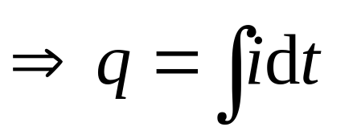
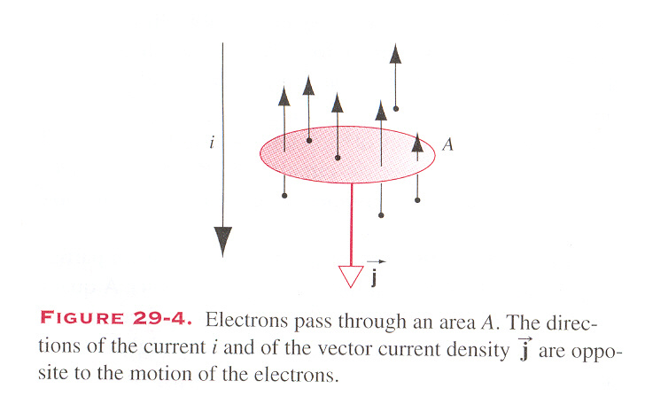
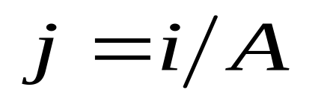
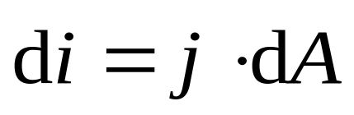

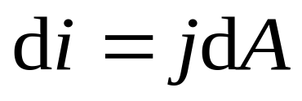
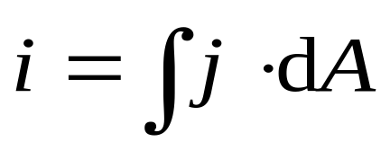
Electric circuit: the continuous loop of flowing
electrons.
The SI unit ampere (A)
1 ampere = 1 coulomb/second
the vector current density j
More accurately,
The direction of the vector current density j are opposite to the motion of the electrons.

Slide 5
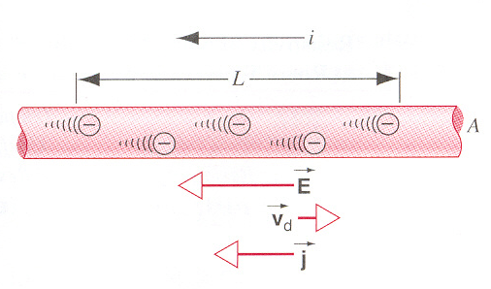
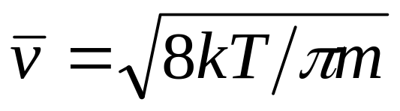
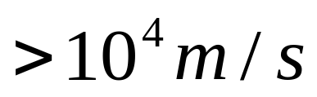
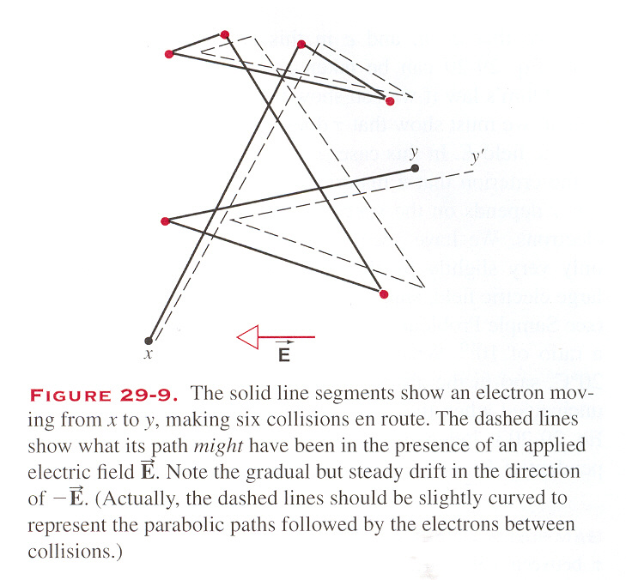
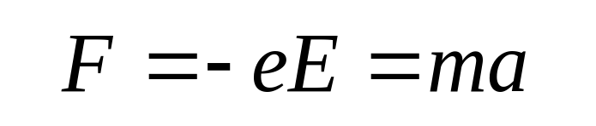
The net motion of electrons is a drift in the direction opposite to the field.
electrons continually lose energy in collisions with the ions of conductor lattice.
What is the speed of electrons ?
Consider the motion of electrons in a portion of the conductor of length L.
On the average, electrons can be described as moving with a constant drift velocity v_{d} in a direction opposite to the field:

Slide 6
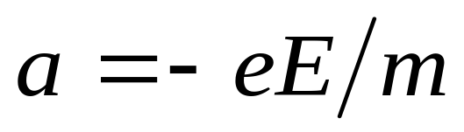
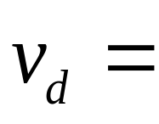
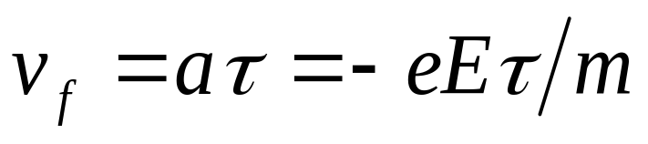
The net motion of electrons is a drift in the direction opposite to the field.
electrons continually lose energy in collisions with the ions of conductor lattice.
What is the speed of electrons ?
Typically, in conductor v_{d}～10⁻⁵ m/s,

Slide 7
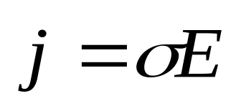
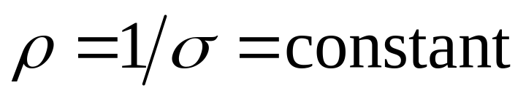
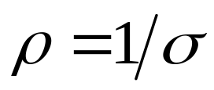
Ohmic Materials
In the external path of a circuit, the direction of current density j is the same as that of the electric field E. So, it is reasonable that j should be proportional to E:
ohm’s law
Remark:
electrical conductivity
The larger the value of σ is, the better conductor is for electric current.
2. The SI unit for conductivity is the siemens
3. The inverse of the conductivity is called resistivity
Ohmic materials

Slide 8
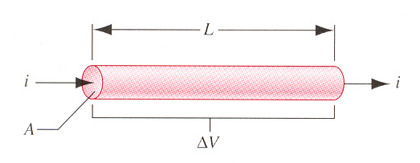

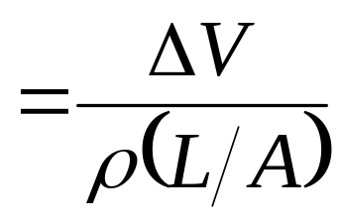
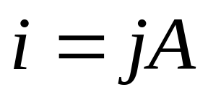
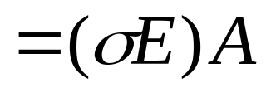
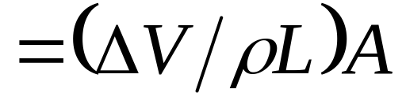
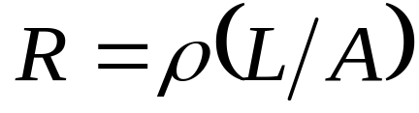
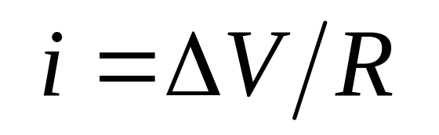
Ohmic’s Law
The conductor of length L and uniform cross-sectional area A, to which a field with a potential difference ΔV is applied
Here,
Ohmic’s Law

Slide 9
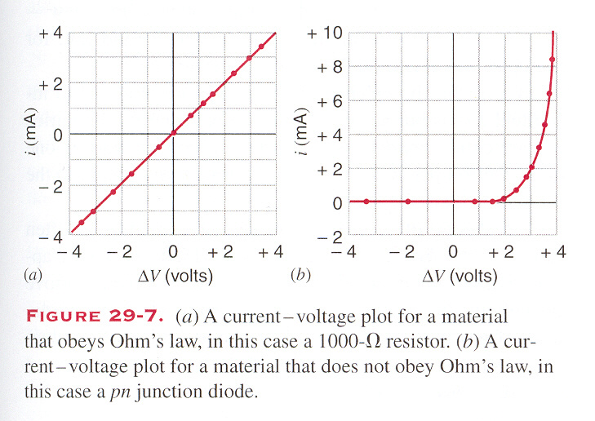
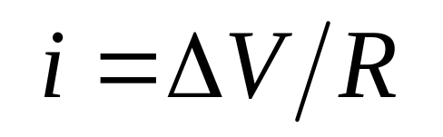
The following plot illustrates the difference between the ohmic materials :

Slide 10
The following plot illustrates the difference between the ohmic materials and non-ohmic materials:

Slide 11
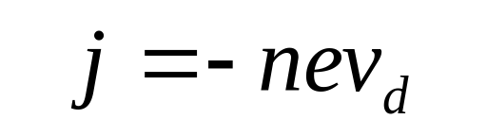
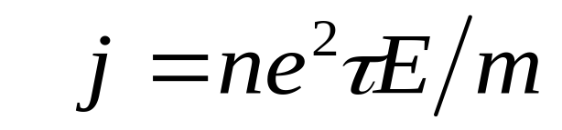
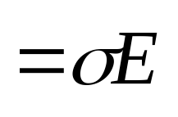
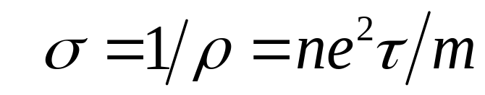
Ohm’s Law: A Microscopic View
Ohm’s law is not a fundamental law of electromagnetism. It can be interpreted by the principle of Mechanics, Thermodynamics and Coulomb’s law.
The electrons collide with the ions of the lattice and transfer energy to them. As a result, the motion of individual electrons is irregular:

Slide 12
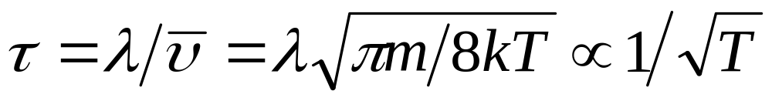
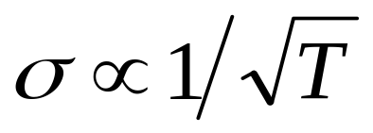
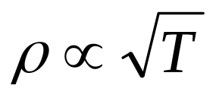
Ohm’s Law: A Microscopic View
By Maxwell velocity distribution,
ρ
in agreement with experiments
T

Slide 13
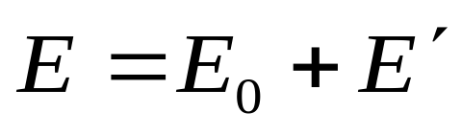
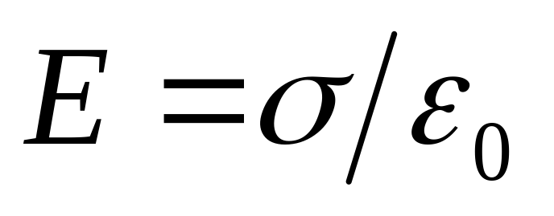
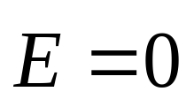
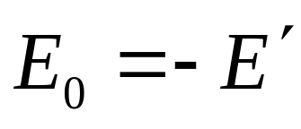
Materials
Conductor
The excess charge must be on the actual outer surface of the conductor.
The smaller the radius of the conducting sphere, the larger is the electric field strength just outside its surface.
conductor is at the same potential
V=constant
The net field in conductor
In conductors, each atom gives up one or more of its valence electrons to the entire material, which are free to move in an external electric field E₀
There is no charge in the interior of the conductor.
Insulator
?
not free to move under the applied electric fields.
The electric field in the interior of an insulator can have nonzero value.
Semiconductor
Superconductors

Slide 14
Semiconductors
Commonly used semiconductors include silicon, germanium and lots of compounds. Semiconductors have played an important role in modern electronic technology.
In a semiconductor, perhaps per 10¹⁰ ~10¹² atoms might contribute one electron to the flow of electricity (electric current) in the material.
Understanding the behaviors of semiconductors requires the knowledge of Quantum Mechanics.

Slide 15




Superconductors
Under certain conditions, often involving cooling to very low temperatures, electric charge can flow through some material with no resistance at all .
The materials under these conditions are called superconductors.
Understanding superconductivity does also need Quantum Mechanics.

Slide 16
Insulator
not free to move under the applied electric fields.
The electric field in the interior of an insulator can have nonzero value.
Why?
What is the value?
In insulators the molecules have permanent dipole moments.
The electrical properties of an insulator may depend on the sum of the electric dipole moments of the molecules.

Slide 17
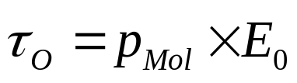
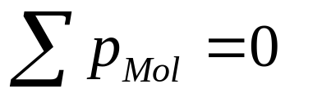
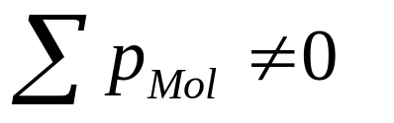
q
E₀
Ο
−q
E₀
Before the external electric field is applied,
After the external electric field is applied,
The effect of aligning of the molecule dipole moments is called polarization.

Slide 18
E₀
the external electric field is removed,
the external electric field is applied,

Slide 19
E₀
the external electric field is removed,
the external electric field is applied,
Ferroelectric insulators:
In ferroelectric insulators, the alignment of the dipoles remains even when we remove the applied field.

Slide 20
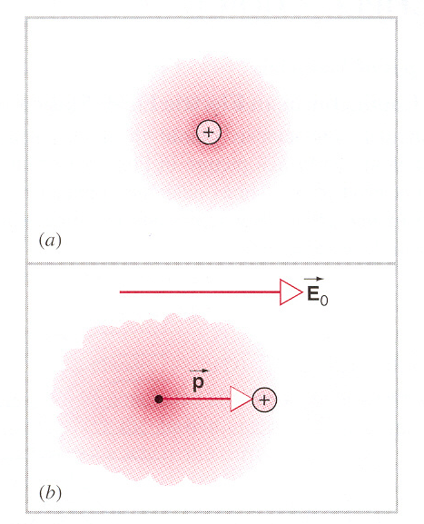

Slide 21


After the external electric field is applied,
So that the polarization happens:
Breakdown
After a large electric field is applied,
the electrons available to move, the material is a conductor rather than an insulator.
the molecules can be ionized

Slide 22
E₀
Before the external electric field is applied,
After the external electric field is applied,
Non-polar insulators

Slide 23







As a result, the induced surface charges will establish an electric field E' that is opposite to the applied E₀ inside the insulator
An Insulator in an Electric Field
a slab of insulating material is placed into an electric field, the dipole moments of the molecules will be aligned along the field:
A Conductor in an Electric Field
Suppose we place a rectangular slab of a conductor in a uniform electric field E₀,
To describe this weakness of the electric field in an insulator, we often define the dimensionless “dielectric constant” k_{e} :
Inside the insulator,

Slide 24





Equivalently, we can define the “permittivity” ε with dimensionality :
The table shows values of the dielectric constants for some materials at T≈300K:

Slide 25












r<r₁
example
k_{e}
r₃, r₂
-q’
q’
r₁ <r<r₂
q, r₁
r₂ <r<r₃
E=?
V=?
σ=?
r>r₃

Slide 26

example
+
+
+
+
+
+
+
+
+
+
+
+
+
+
+
+
+
+

Slide 27

example
+
-
+
-
+
-
+
-
+
-
+
-
+
-
-
+
+
-

Slide 28












example
+
-
+
-
+
-
+
-
+
-
+
-
+
-
+
-
+
-
-
+
-
+
-
+
-
+
-
-
+
-
+
+
+
-
-
+

Slide 29
Exercises
P 675~676 3, 15, 31
Problems
P 677~678 6, 15

